Slide 1
Day of Pentecost
First English Lutheran Church
Butler, Pennsylvania
June 8, 2025

Slide 3
GREETING
The grace of our Lord Jesus Christ, the love of God, and the communion of the Holy Spirit be with you all.
And also with you.

Slide 4
KYRIE

Slide 5
KYRIE

Slide 6
THIS IS THE FEAST

Slide 7
THIS IS THE FEAST

Slide 8
PSALM 104:24-34, 35b
²⁴ How manifold are your | works, O Lord! In wisdom you have made them all; the earth is full | of your creatures. ²⁵ Yonder is the sea, great and wide, with its swarms too man- | y to number, living things both | small and great. ²⁶ There go the ships | to and fro, and Leviathan, which you made for the | sport of it. ²⁷ All of them | look to you to give them their food | in due season. ²⁸ You give it to them; they | gather it; you open your hand, and they are filled | with good things. ²⁹ When you hide your face, | they are terrified; when you take away their breath, they die and return | to their dust.

Slide 9
³⁰ You send forth your Spirit, and they | are created; and so you renew the face | of the earth. ³¹ May the glory of the Lord en- | dure forever; O Lord, rejoice in | all your works. ³² You look at the earth | and it trembles; you touch the mountains | and they smoke. ³³ I will sing to the Lord as long | as I live; I will praise my God while I | have my being. ³⁴ May these words of | mine please God. I will rejoice | in the Lord. ^{35b} Bless the Lord, | O my soul. Hal- | lelujah!

Slide 10
Gospel Acclamation
Choir:
Bright and in likeness of fire,
on those who await his appearing,
he whom the Lord had foretold
suddenly, swiftly descends: Refrain

Slide 11
Gospel Acclamation
Choir:
Daily the loveliness grows,
adorned with the glory of blossom;
heaven its gates now unbars,
flinging its increase of light: Refrain

Slide 13
NICENE CREED
We believe in one God,
the Father, the Almighty,
maker of heaven and earth,
of all that is, seen and unseen.
We believe in one Lord, Jesus Christ,
the only Son of God,
eternally begotten of the Father,
God from God, Light from Light,
true God from true God,
begotten, not made,
of one Being with the Father;
through him all things were made.
For us and for our salvation
he came down from heaven,
was incarnate of the Holy Spirit and the virgin Mary
and became truly human.

Slide 14
For our sake he was crucified under Pontius Pilate;
he suffered death and was buried.
On the third day he rose again
in accordance with the scriptures;
he ascended into heaven
and is seated at the right hand of the Father.
He will come again in glory to judge the living and the dead,
and his kingdom will have no end.
We believe in the Holy Spirit, the Lord, the giver of life,
who proceeds from the Father and the Son,*
who with the Father and the Son is worshiped and glorified,
who has spoken through the prophets.
We believe in one holy catholic and apostolic church.
We acknowledge one baptism for the forgiveness of sins.
We look for the resurrection of the dead,
and the life of the world to come. Amen.

Slide 15
Peace be with you!
Please share the peace in the chat!

Slide 16
Great Thanksgiving

Slide 17
HOLY HOLY HOLY

Slide 18
LAMB OF GOD

Slide 20
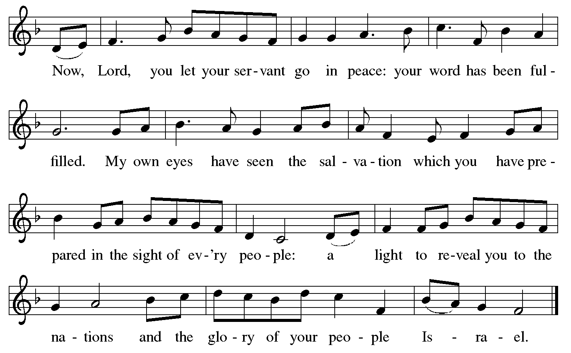
SONG AFTER COMMUNION

Slide 22
Liturgical portions of today’s services are projected with permission under Augsburg Fortress Liturgies Annual License #SAS028762.
COPYRIGHT INFORMATION:
O HOLY SPIRIT, ENTER IN. Text: Michael Schirmer, 1606-1673; tr. Catherine Winkworth, 1827-1878, adapt. Music: WIE SCHÖN LEUCHETET, Philipp Nicolai, 1556-1608.
LIKE THE MURMUR OF THE DOVE’S SONG. Text: Carl P. Daw Jr., b. 1944. Music: BRIDGEROOM, Peter Cutts, b. 193.7. Text: © 1982 Hope Publishing Company. Music: © 1969 Hope Publishing Company, Carol Stream, IL 60188. All rights reserved. Used with permission.
HAIL THEE, FESTIVAL DAY!. Text: Venantius Honorius Fortunatus, 530-609; tr. Lutheran Book of Worship. Music: SALVE FESTA DIES, Ralph Vaughan Williams, 1872-1958. Text: © 1978 Lutheran Book of Worship, admin. Augsburg Fortress. Outside USA: Music from The English Hymnal, © Oxford University Press 1906.
CREATOR SPIRIT, HEAVENLY DOVE. Text: Rhabanus Maurus, 776-856; tr. composite. Music: KOMM, GOTT SCHÖPFER, J. Klug, Geistliche Lieder, 1543.
GOD OF TEMPEST, GOD OF WHIRLWIND. Text: Herman G. Steumpfle Jr., 1923-2007. Music: CWM RHONDDA, John Hughes, 1873-1932. Text: © 2000 GIA Publications, Inc. 7404 S. Mason Ave., Chicago, IL 60638. www.giamusic.com. 800.442.3358 All right reserved. Used by permission.
ONE LICENSE LICENSING PERMISSION:
REPRINTED/PODCAST/STREAMED WITH PERMISSION UNDER
ONE LICENSE #A-734698.
ALL RIGHTS RESERVED.

